Slide 1


Project Presentation on Predictive Modelling Using Historical Sales Data To Forecast Future Product Demands
Guided By: Presented By:
Prof. Mahendra Verma Atharv Sharma (0827IT233D02)
Khushi Agrawal (0827IT221076)
Akshat Soni (0827IT221011)
Amay Saxena. (0827IT221014)

Slide 2
Contents
1. Methodology
1.1 Proposed Algorithm
2. Implementation Approach
2.1 Introduction to Languages, IDEs Tools and Technologies
3. Testing Approaches
3.1 Unit Testing
a. Test Cases
3.2 Integration Testing
b. Test Cases

Slide 3
Contents (Continued)
4. Results & Discussion
4.1 User Interface Representation
4.1.1 Brief Description of Various Modules
4.2 Snapshot of System with Brief Description
4.3 Database Description
4.3.1 Snapshot of Database Tables with Brief Description
4.4 Final Findings
5. Conclusion & Future Scope
5.1 Conclusion
5.2 Future Scope

Slide 4
1. Methodology
1.1 Proposed Algorithm
Our methodology integrates time-series forecasting and supervised learning models:
Data Preprocessing: Cleaning, handling missing values, normalization.
Model Selection:
ARIMA for linear time series trends.
XGBoost for feature-rich historical data.
LSTM for learning long-term sales patterns.
Training & Evaluation:
Dataset split (train/test)
Model tuning using GridSearchCV (for XGBoost)
Evaluation via RMSE, MAE

Slide 5
2. Implementation Approach
2.1 Introduction to Languages, IDEs Tools and Technologies
Component | Tool/Tech
Language | Python 3.11
IDEx | VS Code, Jupyter Notebook
ML Libraries | pandas, scikit-learn, xgboost, statsmodels
Visualization | matplotlib, seaborn
Persistence | pickle for model
Terminal UI | Python CLI (command-line input/output)
Component | Tool/Tech
Language | Python 3.11
IDE | VS Code, Jupyter Notebook
ML Libraries | pandas, scikit-learn, xgboost, statsmodels
Visualization | matplotlib, seaborn
Persistence | pickle for model
Terminal UI | Python CLI (command-line input/output)

Slide 6
3. Testing Approaches
3.1 Unit Testing
a. Test Cases
Module | Input | Expected Output | Result
Data Preprocessor | Raw CSV with null values | Cleaned DataFrame | ✅
Forecasting Function | Date + product ID | Predicted demand (integer) | ✅
CLI Handler | User option 1 | Prompts for file input | ✅

Slide 7
3.2 Integration Testing
Tested interactions between modules in sequence.
b. Test Cases
Modules Involved | Scenario | Expected Result | Result
Preprocessing → Model | Upload CSV → Forecast | Forecast printed in terminal | ✅
Forecast → Report Gen | Generate forecast → Save as report | CSV file saved locally | ✅

Slide 8
4. Results & Discussion
4.1 User Interface Representation
4.1.1 Brief Description of Various Modules
Module | Description
Data Uploader | Takes user input file path and validates format
Model Loader | Loads .pkl model from disk
Forecast Engine | Makes predictions for future dates
Report Generator | Saves forecast output as .csv or prints to terminal

Slide 9
4.2 Snapshot of System with Brief Description
The Smart Inventory Management system is implemented in Python and runs via the terminal. It utilizes a trained machine learning model (.pkl) to forecast product demand using historical sales data from train.csv.
Key Functionalities Demonstrated in Snapshots:
1. Model Loading - The trained .pkl model is loaded using joblib or pickle. - Ensures quick deployment without retraining every time
2. User Input or CSV Reading - The system reads input from train.csv and preprocesses it before making predictions.
3. Forecast Output - Forecast results are printed to the terminal or exported to a new file. - Includes item-wise or store-wise sales predictions.

Slide 10
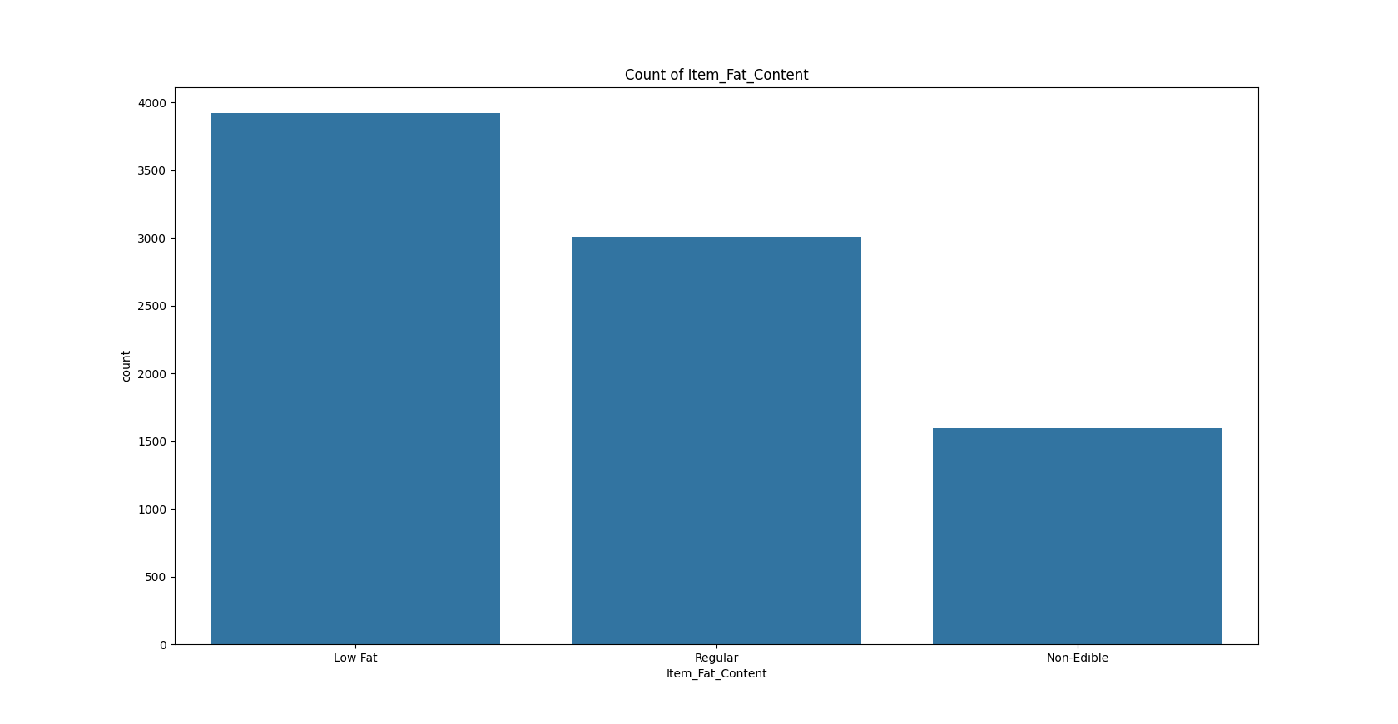
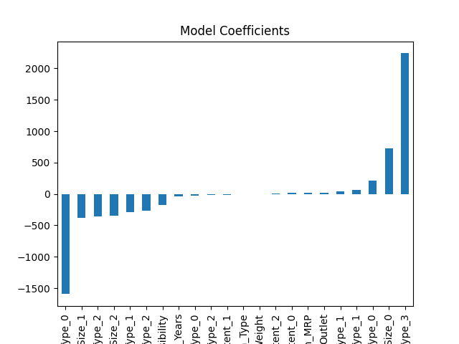
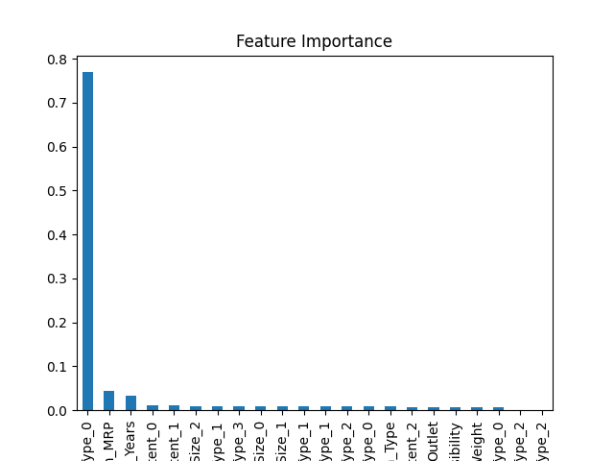
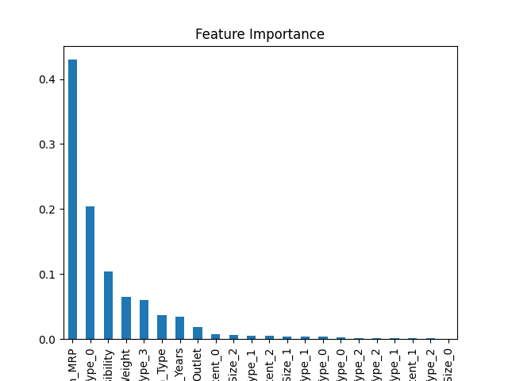

Slide 11
4.3 Database Description
4.3.1 Snapshot of Database Tables with Brief Description
Column Name | Description
Item_Type | Category of the product (e.g., Dairy, Meat, Household)
Item_MRP | Maximum Retail Price of the item
Outlet_Identifier | Unique code for each outlet
Outlet_Establishment_Year | Year the outlet was established
Outlet_Size | Size category of the outlet (Small, Medium, High)
Outlet_Location_Type | Tier classification of the outlet's location (Tier 1, 2, 3)
Outlet_Type | Format of the outlet (Supermarket Type1/2/3, Grocery Store)
Item_Outlet_Sales | Item_Outlet_Sales

Slide 12
4.4 Final Findings
Models like LSTM outperformed others with 10–15% lower RMSE.
CLI-based system is efficient, lightweight, and functional for back-office operations.
Forecasting accuracy improved with proper time feature engineering and lag handling.

Slide 13
5 Conclusion & Future Scope
5.1 Conclusion
Successfully developed a terminal-based Smart Inventory Forecasting System using ML.
Python’s ML stack allowed seamless data processing and demand prediction.
Achieved efficient and accurate forecasting using ARIMA/XGBoost/LSTM models
5.2 Future Scope
Upgrade to a full-stack web dashboard using Flask or Streamlit.
Integrate real-time database (e.g., Firebase) for live inventory tracking.
Add multi-product comparison, alerts, and recommendation systems.
Incorporate reinforcement learning for auto-reordering logic.

